Slide 1

Don Bosco Institute of Technology Information Technology Car Maintenance Assistant Members: 1.Sahil Velhal (60) 2. Amit Kumar Yadav (62) 3. Pratik Zinjurde (64) Guide: Prof. Janhavi Baikerikar

Slide 2
Introduction
Cars have become an important part in daily life
Thousands of rupees for maintenance and repairment.
Current condition of parts of their cars.
If live condition/status of vehicle’s part is measured and appropriate steps are taken to repair damage then It will help car to increase its lifetime.
Reduce further wear and tear of car resulting in better performance.
So, use of IOT & web technologies can be effective solution to solve these problems

Slide 3
Problem Statement
Regular maintenance.
Proposed application aims to provide a platform for car users to find comprehensive information about condition and statistical data of various parts of their car using IOT technology.
Application also aims to provide information about nearby service Centres which offer related services using Web App.

Slide 4
Scope
Vehicle condition & Maintenance
1. Keeping track of various parts of vehicle through IOT and provide statistical representation of data to user through web app.
2. If condition of a part deteriorates , then provide user with information about nearby service centers offering related services.
Chatbot for live interaction.
Location of Nearest service centers.

Slide 5
Literature Survey
Category & Year of Publications | Features/Algorithms/Technique | Identified Gaps
Vehicle Service Management and Live Monitoring With Predictive Maintenance System - 2019 | Automation with IoT makes the whole experience of car. | Tracking location,website
An IoT Based Predictive Connected Car Maintenance Approach - 2017 | MQTT Protocol - MQTT is an extremely lightweight messaging protocol. | Tracking location
Order Management System for Time and Quantity Saving of Recipes Ingredients Using GPS Tracking Systems - 2021 | GPS Tracking systems, HODI Android App | -
Real Time Databases for Applications - 2017 | Transferring data realtime with firebase | -
Positioning and Navigation System Using GPS - 2006 | Hardware(sensors) to track location | no web/android connectivity explained

Slide 6
Hardware Software Requirements
Hardware Requirements:
Arduino & WIFI Module : To collect data from all nodes and send it to server
Temperature sensor : To monitor temperature of engine
Voltage Detector : To monitor voltage of battery
GPS module : To get location of vehicle to find nearby service centers
Software Requirements:
Firebase Realtime DB, Storage: Document and key-value database, will be used to store and retrieve user and vehicle’s data
Chart.js Library : Open-source JavaScript library for data visualization
OpenStreetMap : OpenStreetMap is a collaborative project to create a free editable geographic database of the world.
Bootstrap | HTML | CSS | JavaScript : For designing, styling and making web pages interactive

Slide 7
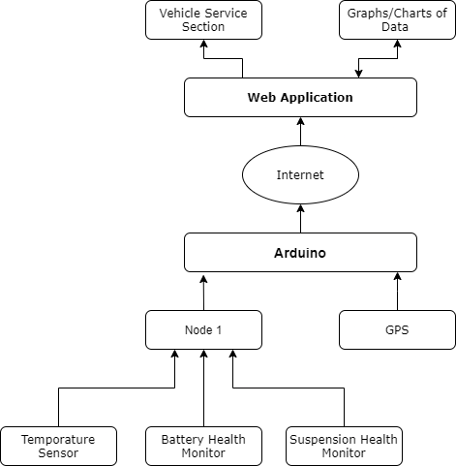
Design
Block Diagram

Slide 8
Practical Information Collected
VISIT TO SERVICE CENTRE.
Company name | Information asked | Information received | Data of visit
Volkswagen | Working of the ECU how it is connected to car components. | Basic information of ECU and latest technology used in cars. | 06/10/2021
Tata motors | Connection of the sensors. with Control units and thresholds values of various components of the car. | The Manager contacted Senior manager and he told that after getting a proceed sign with senior manager we will give you the information you need or possible for us to give | 16/10/2021

Slide 9
Company name | Information needed | Information received | Date of visit
Honda | Connection of the various ECUs of the car with sensors and with OBD cable and how to collect the reading from control unit to Arduino Board. | No allowed to share any kind of information or doing survey in company. | 22/10/2021
Toyoto | Connection of the various ECUs of the car with sensors and with OBD cable and how to collect the reading from control unit to Arduino Board. | Visit next Month. | December.

Slide 10
Implementation
The major functionality of this product is divided into two services
Car Owner
Maintenance & Status
Car Owner:
User will have access to web app by entering his credentials(email & password)
On web interface, All the statistical data about vehicle like Engine Temperature, Battery Voltage will be shown along with Moving Average of last 7 Days.
Current Condition of Vehicle whether It’s good, moderate or Critical will also be shown.
Part which is critical and needs to be repaired will be shown to user.

Slide 11
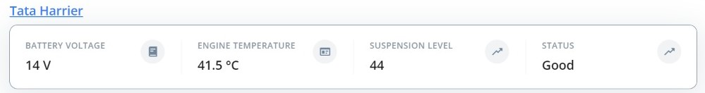
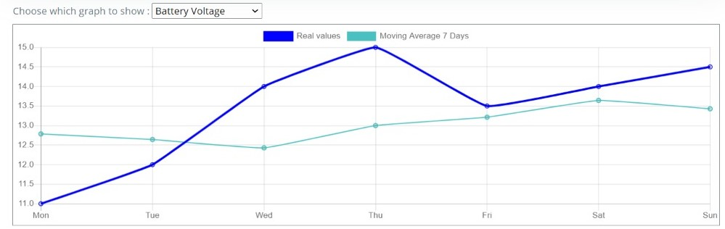
Implementation
Status Bar
Graph based on Data fetch from IOT unit:

Slide 12
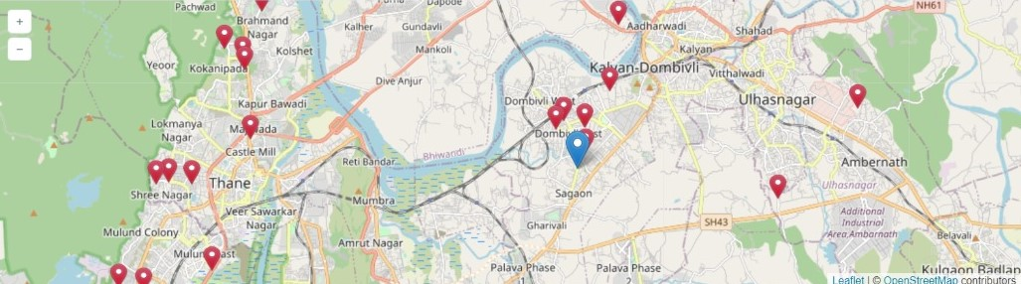
Implementation
Maintenance & Status
Status of the car whether It’s good, moderate or critical will be decided on basis of values fetched from IOT unit. If certain part doesn’t satisfy the range of values as decided by threshold, then It’s not in proper condition and It needs maintenance.
Location of nearest service centers will be also provided on Map

Slide 13
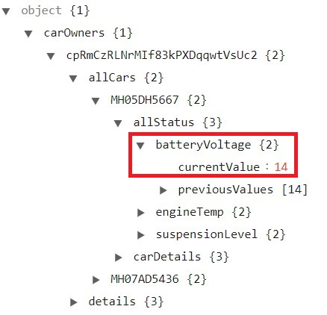
Implementation
Firebase & IOT integration:
Once connected, Arduino will collect live data from sensors attached to its ports and will upload data on Firebase cloud with help of Wi-Fi module.
Data will keep on updating on Firebase real-time database with certain interval of time (e.g. 5 s)

Slide 14
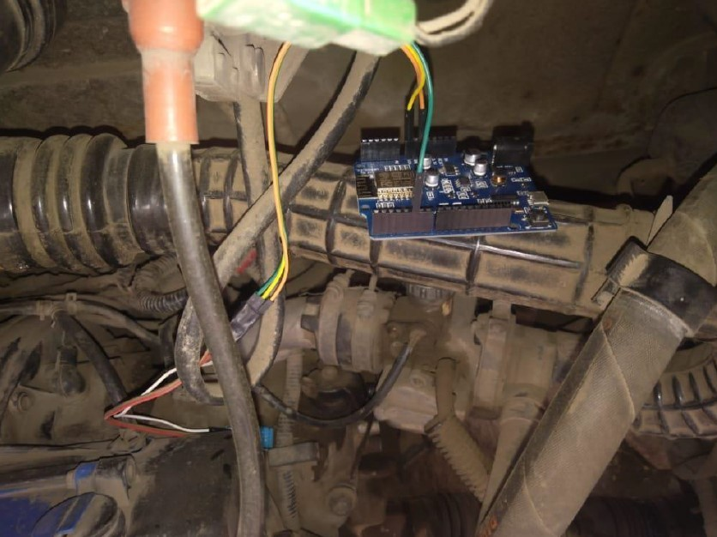
Implementation
Hardware Connection
DH11 sensor which is used to measure Temperature is placed Near Vehicle engine.
It is connected with the Arduino which is taking the reading of the engine temperature and sending the value to firebase in real time database with help of Wi-Fi-module.

Slide 15
Future Scope
More relevant parameters can be added to monitor health of the car.
Single score for a car can be calculated which can be used for measuring health of the car.
Some of the parts of the car like engine oil require periodic maintenance/replacements, so a separate provision can be made.
Provision for non technical service like Insurance can be provided.

Slide 16
References
S. A. Hameed, O. Khalifa, M. Ershad, F. Zahudi, B. Sheyaa and W. Asender, "Car monitoring, alerting and tracking model: Enhancement with mobility and database facilities," International Conference on Computer and Communication Engineering (ICCCE'10), 2010, pp. 1-5, doi: 10.1109/ICCCE.2010.5556796. https://ieeexplore.ieee.org/document/5556796
KR, Parmesh & Neriya, Rashmi. (2016). Vehicle Health Monitoring and Analysis. 10.13140/RG.2.2.27229.51684. https://www.researchgate.net/publication/318309405_Vehicle_Health_Monitoring_and_Analysis

Slide 17
Thank You!

